Slide 1
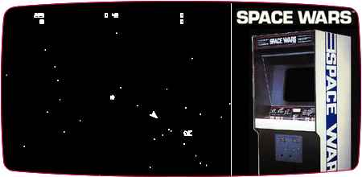
Modular of Aspects
Final Project,
SpaceWars AOP
Aviv Kotek, Raz Warman

Slide 2
We will:
Use Java code with AspectJ for implementing Aspects.
Use Normal aspects syntax AND @AspectJ annotations style – practice annotations (more readable, “new” java style).
Implement our own annotations as pointCuts.
Add functionality to the game.
Logg, audit and control game behavior.
Analyze game behavior… and more!

Slide 3
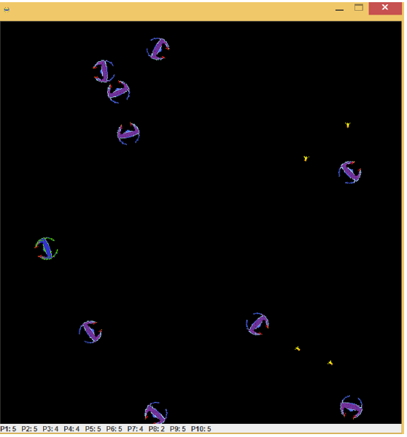
Base class: SpaceWars
Space Wars is a 1977 vector graphics arcade game based on the 1962PDP-1 program Spacewar!.
We will use the version written by us in OOP course.

Slide 4
Base class design
COMPLETE MAIN DESIGN OF SYSTEM….

Slide 5
Our main Aspects:
Spectative aspects:
Game Logging Aspect – saves data about game (time took, num of shots, start of game, etc..)
Audit Aspect - logs game events using method signature, for auditing (security) and data analysis.
Regulative Aspects:
Lock aspect: locks some feature of the player - for e.g: can’t shoot anymore.
Password authorization mechanism – only authorized users can play the game (using password).
UI update aspect: each time some value is change (e.g: asteroid is hit) - we display it on screen.
Invasive Aspects:
Heuristic aspect: changes heuristic of the game (change from drunk player to smart player).
ExceptionHandler Aspect – Monitors exceptions and handles unhandled exceptions.
Testing aspect – unitests……..?

Slide 6
In details

Slide 7
Spectative Aspects

Slide 8
Spectative Aspects:
Instead of scattering the use of logger object (logger.log(type, msg)) in all of our program, we use an aspect to control logging.
Usage of annotations TODO
Game Logging
Aspect
Audit
Aspect

Slide 9
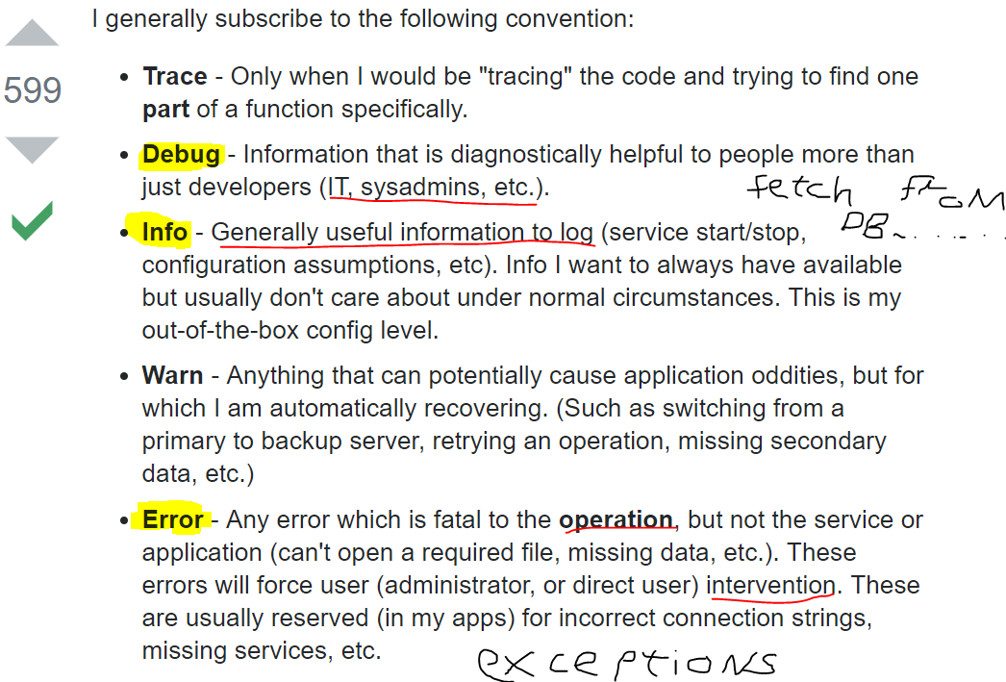
Log4j2
Apache license (open source) software, since 2001.
Most common logging framework in the java world.
Logging levels:
DEBUG, INFO, ERROR
Configure by.xml – separated from app
Can change logging level on RUNTIME!!
We logged in a synchronous way

Slide 10
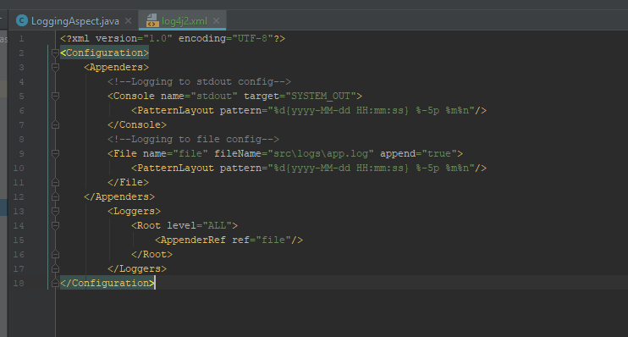
Log4j2 config file

Slide 11
Game Logging Aspect:
Instead of scattering the use of logger object (logger.log(type, msg)) in all of our program, we use an aspect to control logging.
Pointcut:
Game analysis - total time game took, total shoots made, total collisions.
Main game events – use custom annotation - @Loggable annotation to use in methods that do not conform with wildcard pattern. Log them to file and print to STDOUT to inform player.
Advice: Log code into logs/app.log file depends on annotation in runtime.

Slide 12
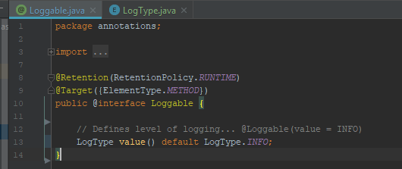
@Loggable
Custom made annotation
Programmer marks method with @Loggable annotation AND it typeLevel!
Retention: Source/Runtime – not-visible/visible by the compiler.
Target: Method – use this annot only on methods.

Slide 13
Audit Aspect:
Logs (audits) data to file, for later monitoring and security. (in real application we would like to log this to RDBMS).
Pointcut:
Set/get operations (after).
Do (interface) operations (after).
Advice: Log code into logs/app.log file depends on annotation in runtime.

Slide 14
Regulative Aspects

Slide 15
Regulative Aspects:
TODO
Lock Aspects
Authorization Aspect
UI Aspect

Slide 16
Lock Aspect:
Locks game features of the game:
Locks shooting option.
Locks shield option.
Locks moving option.
Pointcut:
Advice:

Slide 17
Authorization Aspect:
Password authorization mechanism – only authorized users can play the game.
Enforced using user/password login using STDOUT.
Pointcut:
Advice:

Slide 18
UI Aspect:
Update UI with informative message when fields/values are changed:
SpaceShip is hit.
Teleport executed by SpaceShip.
SpaceShip died.
Pointcut:
Advice:

Slide 19
Invasive Aspects

Slide 20
Invasive Aspects:
Instead of…
ExceptionHandler Aspect

Slide 21
ExceptionHandlerAspect

Slide 22
Testing the aspects

Slide 23
Testing our aspects – unit testing aspects?
Logging Aspect – just by checking the written files. If have time <write uni test to check file>

Slide 24
TODO
StartGame/EndGame message to stdout
Test aspects
Comments of aspects classes ONLY
Log events to database????

